Slide 1

Xinhang Xu
Major in Plasma Physics (Ph.D.)
9 Years in Magnetic Confinement Fusion
Apply Position: Plasma Physicist
Requisition ID: 1156
Xinhang Xu

Slide 2
Education and Research Activities
2016 – 2023 University of Science and Technology of China, EAST
Ph.D. Major in Plasma Physics
Dissertation Title: Numerical Study of the Kinetic Evolution of Non-thermal Electrons in Tokamak and its Influence on Cyclotron Radiation
(1) Plasma theory model development, (2) Diagnostics development and application,
(3) Physics campaign and data interpretation, (4) Model validation
2023 – 2025 University of California at Davis, NSTX-Upgrade
Postdoc, Spherical Tokamak Physics Study and Diagnostics Development
9
(1) Laser-based and microwave-based diagnostics development
(2) Young research mentoring and training program
Self Introduction
Years

Slide 3
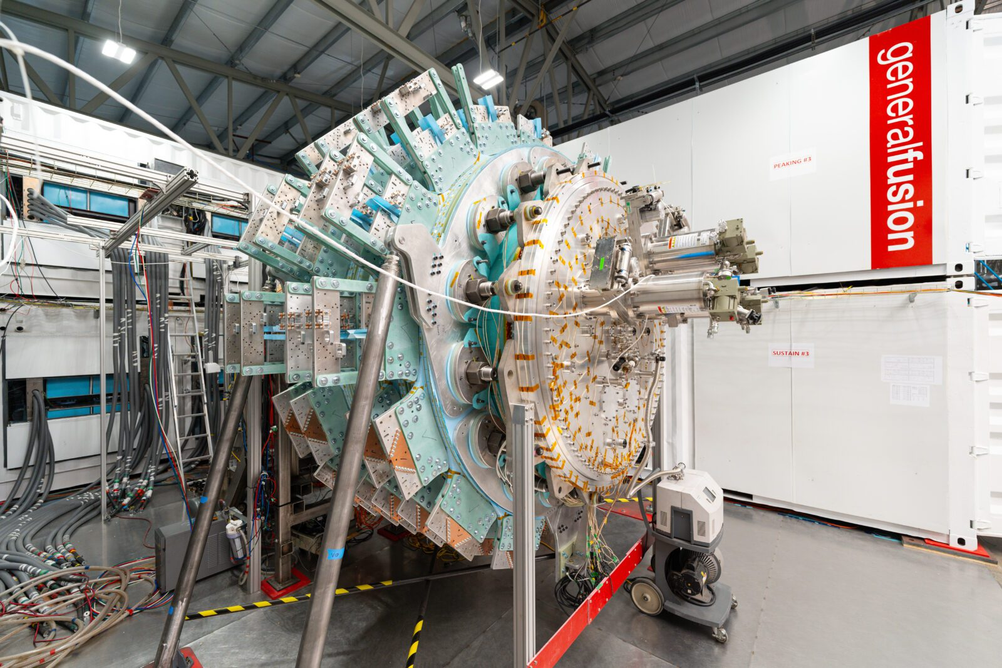
Plasma Physicist
Data interpretation
Propose experiments
R3
R1
Analyze and integrate diagnostic data from General Fusion plasma experiments .
Curate and interpret experimental data.
Propose new experimental campaigns and corresponding simulations to answer key questions regarding plasma parameter evolution and optimization of MTF targets.
Analyze and integrate diagnostic data from General Fusion plasma experiments to develop comprehensive hypotheses for evolution of plasma characteristics and reconcile them with simulation results and reconstructions.
Responsibilities
Work with the simulation, reconstruction, and diagnostic teams to develop dynamic models of spherical tokamak (ST) plasmas under compression.
Model validation
Dynamic model on ST
R2
R4
Reference: https://workforcenow.adp.com/mascsr/default/mdf/recruitment/recruitment.html?cid=3196ba6f-d49c-4493-9290-3d91489bdfa9&ccId=19000101_000001&type=JS&lang=en_CA

Slide 4
Research Activities:
Plasma Theory & Experimental Study
Plasma Theory and Experimental Study

Slide 5
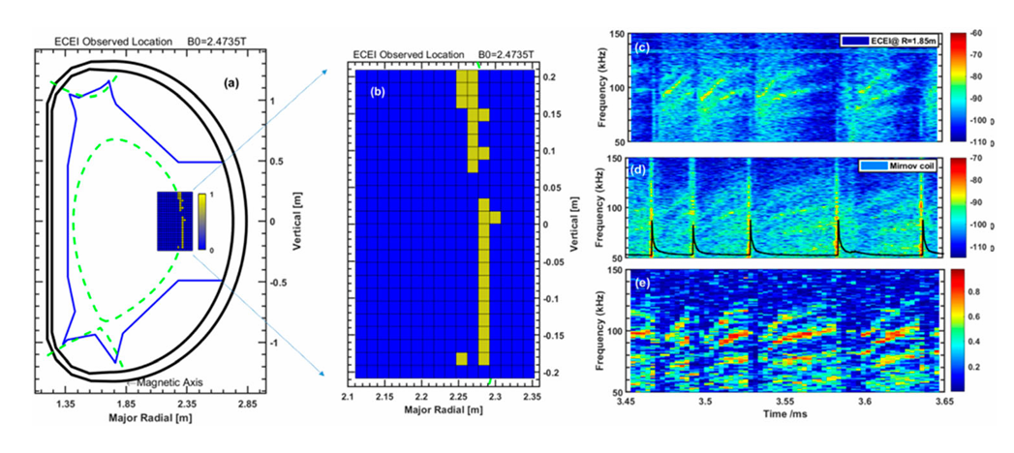
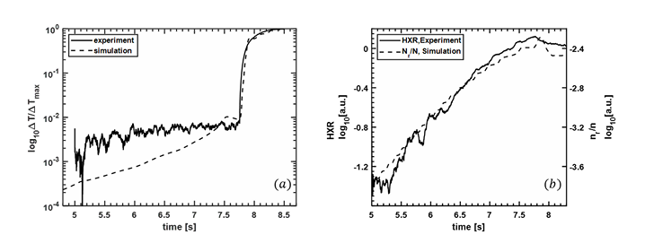
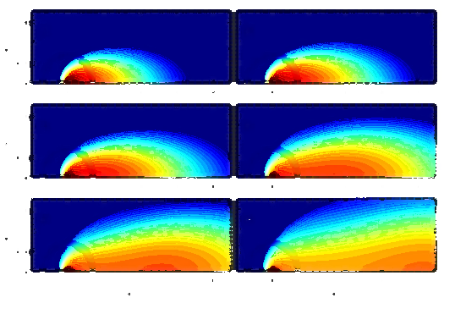
Research Activities:
Plasma Theory & Experimental Study
Confinement Improvement by Understanding Micro-Tearing Modes in ELMs
Non-thermal Electron confinement with Magnetic Perturbations
Utilizing Electron Velocity Distribution Measurements for Enhanced Tokamak Startup Control
Validation of Kinetic Simulation and Synthetic Model
Plasma Theory and Experimental Study

Slide 6
Research Activities:
Confinement Improvement by Understanding Micro-Tearing Modes in ELMs
Qu, C. M., et al. Radiation Effects and Defects in Solids 179.3-4 (2024): 514-524.
The path to practical fusion energy requires minimizing the plasma turbulence to maintain strong confinement.
Electromagnetic Mode [1]
Electron Temperature Gradient [2]
Electron Diamagnetic Drift Direction.
TRANSPORT
Diagnostics:
1D & 2D ECE, DBS, Mirnov coil, Polarimeter- Interferometer
Among the key mechanisms at play, micro-tearing modes stand out as a dominant source of transport in the high-temperature, tokamak edge.
NOT only just an academic exercise.
Gyrokinetic simulations
MTM transport
ELECTRON DIAMAGNETIC
Heat flux
Small particle flux
Plasma Theory and Experimental Study (1/4)
SMALL PARTICLE FLUX
1.The experimental results demonstrate that micro-tearing modes are responsible for a small particle flux.
2.High correlation between fluctuation of Te and Er measured from ECE and DBS.
3. Prove that MTM rotation is in diamagnetic drift direction
It is a prerequisite for designing and optimizing next-generation fusion reactors.
1.Drake, J.F.; Lee, Y.C. Kinetic Theory of Tearing Instabilities. The Physics of Fluids 1977, 20 (8), 1341–53.
2. Jenko, F.; Dorland, W.; Kotschenreuther, M.; Rogers, B.N. Electron Temperature Gradient Driven Turbulence. Phys. Plasmas 2000, 7 (5), 1904–10.
Experimental Study & Validation
Background & Motivation
Theory & Model
R1
R2
R3

Slide 7

Research Activities:
Non-Thermal Electron Confinement with Magnetic Perturbations
Kinetic Simulation
Validation
For better non-thermal electron confinement, it requires understanding of non-thermal electron emission
EAST #53864
Measurement
PARTICLE CONFINEMENT
L[f] : Magnetic perturbation loss operator (Harvey model[1])
REF:
Simulation
Enhanced control of non-thermal electrons leads to improved particle confinement and higher fusion efficiency.
Plasma Theory and Experimental Study (2/4)
Synthetic Diagnostic Module
Non-thermal emission directly reveals the spatial and energy distribution of non-thermal electrons, providing a measure for assessing particle confinement.
Simulate the Electron cyclotron emission based on the electron velocity distribution
The measured proportion of non-thermal electrons validates that the theoretical calculations are in well agreement with experimental results.
The code is released on GitHub.
Background & Motivation
Theory & Model
Experimental Study & Validation
1.Harvey, R. W., et al. Physics of Fluids B: Plasma Physics 5.2 (1993): 446-456.
R1
R2
R4

Slide 8
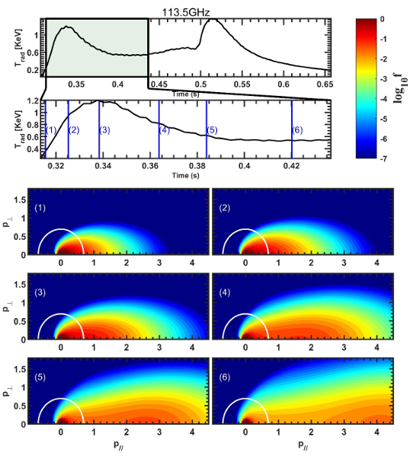
Research Activities:
Utilizing Electron Velocity Distribution Measurements for Enhanced Tokamak Startup Control
Kinetic Simulation
Velocity Distribution Calculation
The velocity distribution function, derived from emission measurements, is utilized in a feedback control system during plasma startup to optimize heating efficiency.
EAST#64987
VELOCITY DISTRIBUTION
By controlling the velocity distribution, heating efficiency during plasma startup can be enhanced, thereby reducing the cost of plasma ignition.
C[f] : Folk-plank collision operator
S_{A}[f]:Avalanche collision operator
Plasma Theory and Experimental Study (3/4)
Synthetic Diagnostic Module
Leveraging existing facilities and diagnostic tools, this study aims to measure and understand the electron velocity distribution functions across different startup scenarios, in order to develop optimized control strategies.
Simulate the Electron cyclotron emission based on the electron velocity distribution
Experimental data from the EAST tokamak, including electric field, density, and temperature during startup, are used to validate the computed electron velocity distribution function.
The code is released on GitHub.
Background & Motivation
Theory & Model
Experimental Study
R1
R2
R4
Notes:
Results: Avalanche process lead to the abnormal emission while the anomalous doppler effect lead to the step structure (Xinhang Xu et al 2025 Chinese Phys. B)

Slide 9
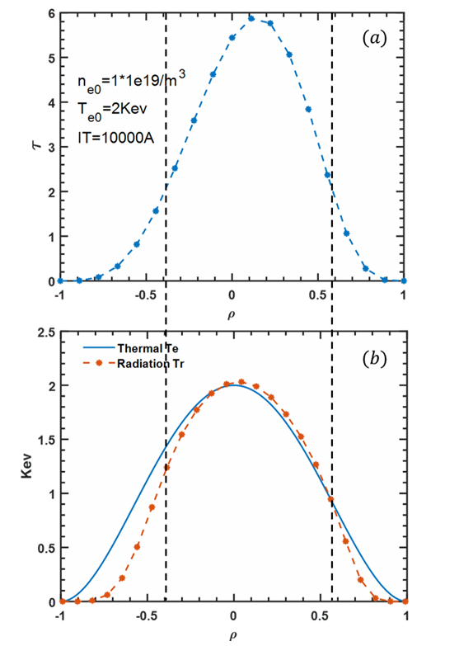
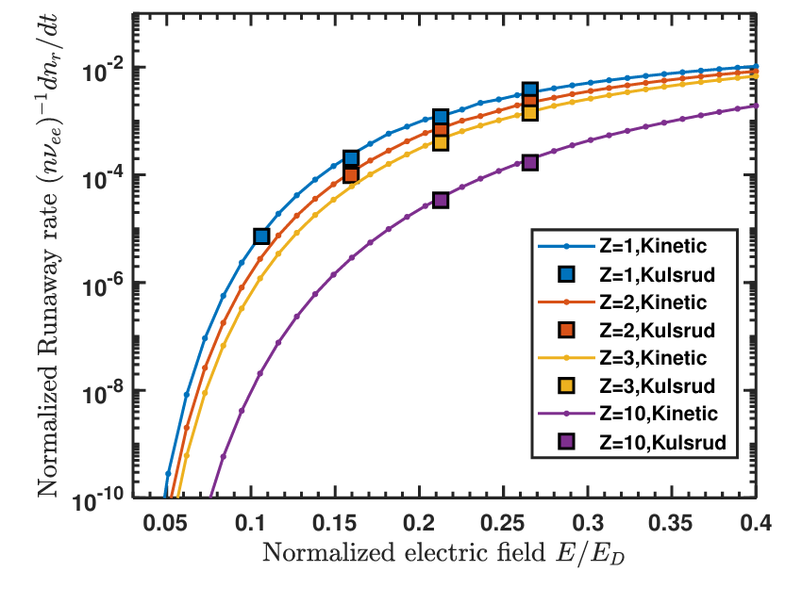
Research Activities:
Validation of Kinetic Simulation and Synthetic Model
Growth Rate of Runaway Electron Density in the Kinetic Model
Synthetic Model
Validate the agreement between electron temperature and radiation temperature by synthetic model.
New Model
Previous Model
Plasma Theory and Experimental Study (4/4)
Electron Temperature
Radiation Temperature
Validate the runaway electron growth rate with previous model (Kulsrud, PRL,1973)
R2
Notes:
Results: Avalanche process lead to the abnormal emission while the anomalous doppler effect lead to the step structure (Xinhang Xu et al 2025 Chinese Phys. B)

Slide 10
Research Activities:
Plasma Theory & Experimental Study
Confinement Improvement by Understanding Micro-Tearing Modes in ELMs
Non-thermal Electron confinement with Magnetic Perturbations
Utilizing Electron Velocity Distribution Measurements for Enhanced Tokamak Startup Control
Validation of Kinetic Simulation and Synthetic Model
Plasma Theory and Experimental Study

Slide 11
Experimental Proposal and Management
Propose New Experimental Campaign and Corresponding Simulations

Slide 12
Experimental Proposal and Management
(1) Key Challenge Targeting
(2) Initial Design
(3) Coordinate with Teams
(4) Execution Plan & Solution
The Critical Knowledge Gap
The Foundation of Existing Work
The Compelling Need for Action
Risk Assessment, Mitigation, and Contingency Planning
Project Timeline and Execution Schedule
Data Management and Curation Plan
Benefit Analysis and Validation Framework
Propose New Experimental Campaign and Corresponding Simulations
Target Plasma Equilibrium Configuration
Resource Allocation & Requirements (Machine, Heating, Diagnostics, Simulation, Computer)
Proposed Project Timeline and Milestones
Initial Project Scope and Expected Outcomes
Meeting Objective: Proposal Kick-off and Alignment
Stakeholder Coordination: Engaging Key Contributors
Critical Discussion: Key Challenges and Points of Focus
Proposal Refinement: Aligning Scope with Real-World Constraints

Slide 13
Experimental Proposal and Management
Key Challenge Targeting
Initial Design
Coordinate with Teams
Execution Plan & Solution
Execution Phase
Delivery Phase
The Critical Knowledge Gap
The Foundation of Existing Work
The Compelling Need for Action
Section Leader: Campaign Overview and Objectives
Chief Operator: Execute Shots According to the Latest Approved Proposal
Diagnostics Coordinator: Ensure Diagnostic Availability and Data Integrity
Chief Scientist: Provide Real-Time Analysis and Shot-to-Shot Guidance
Target Plasma Equilibrium Configuration
Resource Allocation & Requirements (Machine, Heating, Diagnostics, Simulation, Computer)
Proposed Project Timeline and Milestones
Initial Project Scope and Expected Outcomes
Propose New Experimental Campaign and Corresponding Simulations
Meeting Objective: Proposal Kick-off and Alignment
Stakeholder Coordination: Engaging Key Contributors
Critical Discussion: Key Challenges and Points of Focus
Proposal Refinement: Aligning Scope with Real-World Constraints
Risk Assessment, Mitigation, and Contingency Planning
Project Timeline and Execution Schedule
Data Management and Curation Plan
Benefit Analysis and Validation Framework

Slide 14
Experimental Proposal and Management
Key Challenge Targeting
Initial Design
Coordinate with Teams
Execution Plan & Solution
Execution Phase
Delivery Phase
Excellent communication skills and ability to engage effectively with the team.
The Critical Knowledge Gap
The Foundation of Existing Work
The Compelling Need for Action
Section Leader: Campaign Overview and Objectives
Chief Operator: Execute Shots According to the Latest Approved Proposal
Diagnostics Coordinator: Ensure Diagnostic Availability and Data Integrity
Chief Scientist: Provide Real-Time Analysis and Shot-to-Shot Guidance
Target Plasma Equilibrium Configuration
Resource Allocation & Requirements (Machine, Heating, Diagnostics, Simulation, Computer)
Proposed Project Timeline and Milestones
Initial Project Scope and Expected Outcomes
Propose New Experimental Campaign and Corresponding Simulations
Meeting Objective: Proposal Kick-off and Alignment
Stakeholder Coordination: Engaging Key Contributors
Critical Discussion: Key Challenges and Points of Focus
Proposal Refinement: Aligning Scope with Real-World Constraints
Risk Assessment, Mitigation, and Contingency Planning
Project Timeline and Execution Schedule
Data Management and Curation Plan
Benefit Analysis and Validation Framework

Slide 15
Experimental Proposal and Management
Key Challenge Targeting
Initial Design
Coordinate with Teams
Execution Plan & Solution
Execution Phase
Delivery Phase
The Critical Knowledge Gap
The Foundation of Existing Work
The Compelling Need for Action
Section Leader:
Campaign Overview and Objectives
Chief Operator:
Execute Shots According to the Latest Approved Proposal
Diagnostics Coordinator:
Ensure Diagnostic Availability and Data Integrity
Chief Scientist:
Provide Real-Time Analysis and Shot-to-Shot Guidance
Next Day Express Experimental Report
Scientific Publications (Classified and Publication)
Rapid Iteration of Burning Plasma Operations and Machine Development through Knowledge - Guided Experimentation
Target Plasma Equilibrium Configuration
Resource Allocation & Requirements (Machine, Heating, Diagnostics, Simulation, Computer)
Proposed Project Timeline and Milestones
Initial Project Scope and Expected Outcomes
Propose New Experimental Campaign and Corresponding Simulations
Meeting Objective: Proposal Kick-off and Alignment
Stakeholder Coordination: Engaging Key Contributors
Critical Discussion: Key Challenges and Points of Focus
Proposal Refinement: Aligning Scope with Real-World Constraints
Risk Assessment, Mitigation, and Contingency Planning
Project Timeline and Execution Schedule
Data Management and Curation Plan
Benefit Analysis and Validation Framework

Slide 16
Programming and Automation
Programming and Automation

Slide 17


Programming and Automation
9
8,000 +
4
Years Experience
Lines for Scientific Research
Plasma Physics Model Development (Leader)
PRIMARY
1.5
1,000 +
2
Programming and Automation
Years Experience
Lines for Scientific Research
Ray Tracing Calculation and Diagnostics Hardware Controller

Slide 18
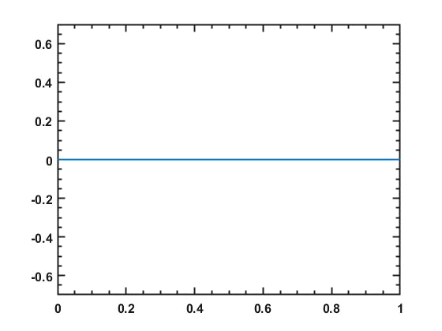
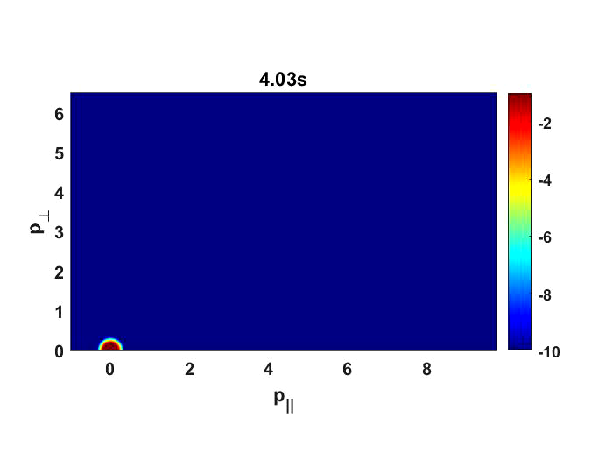
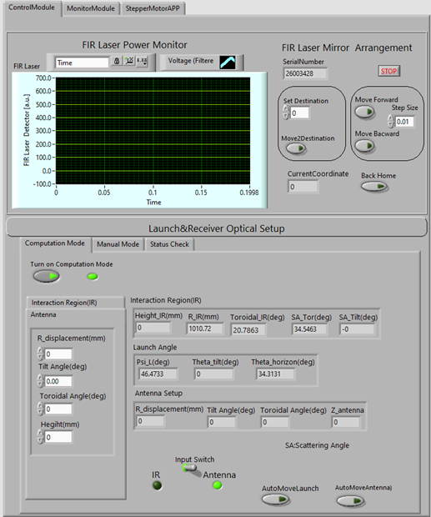
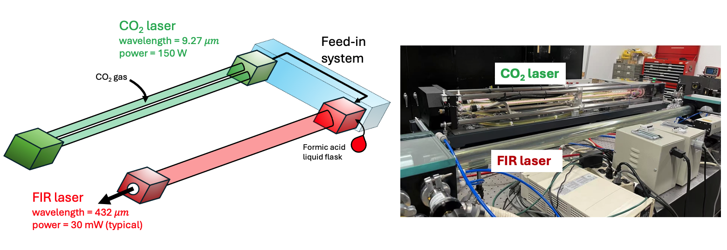
Programming and Automation
MATLAB (Released in 2024)
MATLAB (Released in 2018)
Diagnostic Signal vs. Time
Velocity distribution vs. Time
MATLAB (Released in 2018)
3D Ray Tracing
Programming and Automation
LABVIEW + PYTHON (Released in 2025)
Diagnostic Auto-Calibration and Control
1.3D ray-tracing : https://git.lug.ustc.edu.cn/XuXinhang/ray-tracing3d.git
2.Kinetic + synthetic simulation: https://git.lug.ustc.edu.cn/XuXinhang/kinetic_simulation.git

Slide 19
The Right Skills, The Right Experience
Ph.D. in Plasma Physics in 2023 + 2 Year Postdoc (UC Davis)
9 Years Experience in Fusion Physics and Magnetized Plasma Research
Success on Plasma Physics Model Development and Experimental Validation
Multidisciplinary Research Activities: Plasma Physics, Diagnostic Hardware, Microwave Technology, Laser Development
The Right Skills, The Right Experience
5 Years Team Working Experience and Qualified Communication Skill
(Public Science Facility and Academic Research Group)
Model Development, Data Interpretation, Automation
(MATLAB primary, Python)

Slide 20


"I am excited by the prospect of contributing to new fusion future."
Xinhang Xu
xihxu@ucdavis.edu
xuxh@mail.ustc.edu.cn

Slide 21
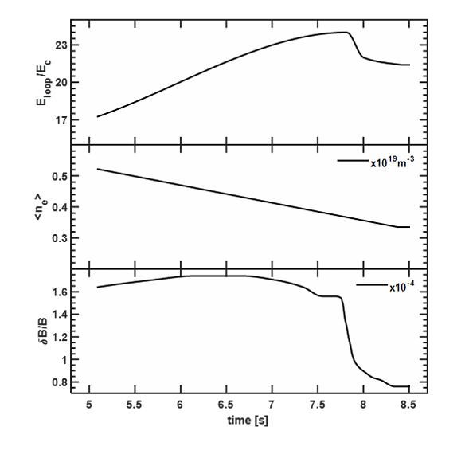
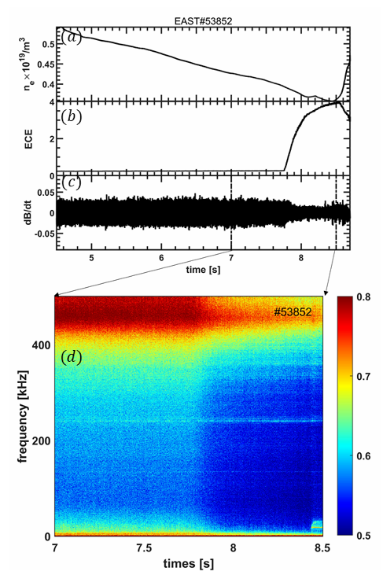

Research Activities:
Non-Thermal Electron Confinement with Magnetic Perturbations
How to understand sudden rise ECE emission?
Input data from experiment
Kinetic simulation
C[f]:Fokker-Plank collision operator
$\frac{∂}{∂p}⋅F_{rad}f$: Radiation damping operator
D[f]: Electromagnetic wave scattering operator
$S_{A}\left[f\right]:$ Avalanche operator
$S_{T}\left[f\right]:$ electron source with thermal distribution
L[f] : Magnetic perturbation loss operator (Harvey model)
Comparison of output parameters with experimental data
Plasma Theory and Experimental Study (2/4)
synthetic diagnostic module
Simulate the Electron cyclotron emission based on the electron velocity distribution
Background & Motivation
Theory & Model
Experimental Study & Validation
R1
R2
R3

Slide 22
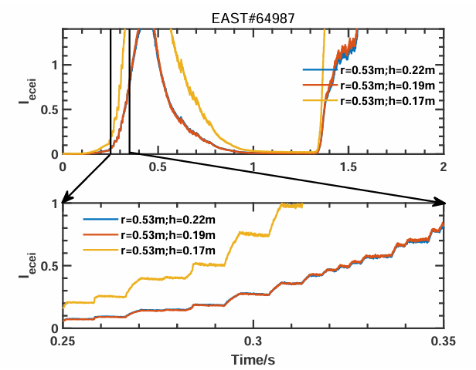

Research Activities:
Utilizing Electron Velocity Distribution Measurements for Enhanced Tokamak Startup Control
Simulation results from experiment
Abnormal increase of ECE emission and step structure in the rise phase
Kinetic simulation
C[f]:Fokker-Plank collision operator
$\frac{∂}{∂p}⋅F_{rad}f$: Radiation damping operator
D[f]: Electromagnetic wave scattering operator
$S_{A}\left[f\right]:$ Avalanche operator
$S_{T}\left[f\right]:$ electron source with thermal distribution
L[f] : Magnetic perturbation loss operator (Harvey model)
Plasma Theory and Experimental Study (2/4)
synthetic diagnostic module
Simulate the Electron cyclotron emission based on the electron velocity distribution
Background & Motivation
Theory & Model
Experimental Study & Validation
R1
R2
R3
Notes:
Results: Avalanche process lead to the abnormal emission while the anomalous doppler effect lead to the step structure (Xinhang Xu et al 2025 Chinese Phys. B)

Slide 23
Research Activities:
Module validation
Synthetic Model
Kinetic Model
Check if the radiation temperature close to thermal temperature under optical thick condition
Plasma Theory and Experimental Study (2/4)
Compare the runaway electron growth rate with previous results (Kulsrud, PRL,1973) under same condition
R2
Notes:
Results: Avalanche process lead to the abnormal emission while the anomalous doppler effect lead to the step structure (Xinhang Xu et al 2025 Chinese Phys. B)

Slide 24
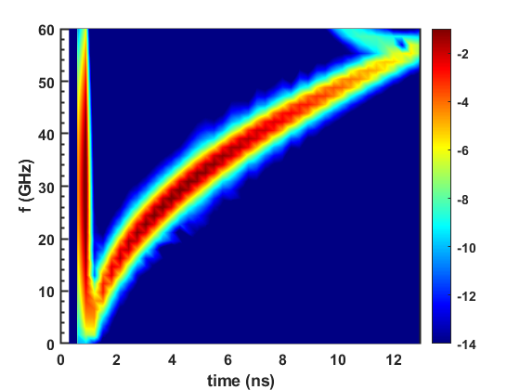
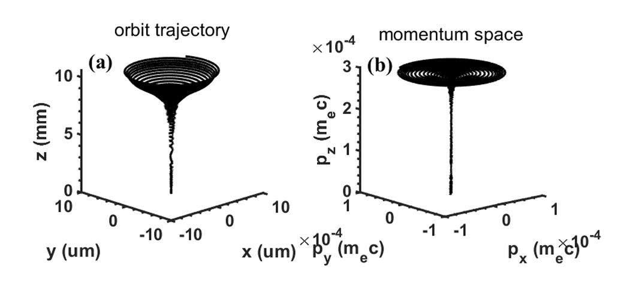
Programming and Automation
Kinetic + synthetic simulation (+2000 lines)
1D-FDTD simulation in plasma for USPR(+2000 lines)
3D ray-tracing simulation (450 lines)
Wave-particle resonant simulation (+500 lines)
Programming and Automation
1.3D ray-tracing : https://git.lug.ustc.edu.cn/XuXinhang/ray-tracing3d.git
2.Kinetic + synthetic simulation: https://git.lug.ustc.edu.cn/XuXinhang/kinetic_simulation.git
3.2D fdtd simulation : https://git.lug.ustc.edu.cn/XuXinhang/fdtd_2d.git

Slide 25

Programming and Automation
High-k laser and TIReTIP(Far-infrared tangential interferometer/polarimeter) diagnostic control and monitor for NSTX-U
Control platform
Programming and Automation
control
monitor
Receive optical adjustment
Launch optical adjustment
System temperature
Optical position
Laser Cavity adjustment
Laser power
feedback
Frequency

